Slide 1

教学辅助课件
牛津 七年级下

Slide 2

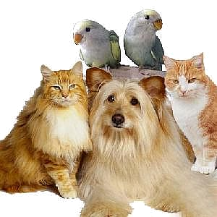
Unit 8
Pets
Integrated skills

Slide 3



New words and expression
weigh
gram
grow up
talk
noise
brush
fur
v. 重；有……重
n. 克
成长；长大成人
n. 讲座；演讲
n. 声音，响声；噪音
vt. 刷；擦
n. (动物的)软毛，毛皮
Read after the tape and speak out the Chinese immediately.

Slide 4

1. To get the general information about goldfish from listening material
2. To be able to talk about pet care
3. To learn the new words and useful expressions: weigh, talk, noise, gram, brush, fur, put … in the sun
once a day, grow up, make some noise
How do you look after your dog?

Slide 5



Free talk
Would you like to have a goldfish as your pet? Why or why not?
Yes, I’d like to…./No,…. Because….

Slide 6


F
Don’t pick up
1. Pick up goldfish with your hands.
2. Put your goldfish in the sun.
3. A goldfish can weigh up to 40
grams.
4. Some goldfish are black.
5. Goldfish are easy to look after.
6. Goldfish are very expensive.
Peter is listening to a talk on goldfish and writing down some notes. Listen to the talk and help him check his notes below. Write a T if a sentence is true or an F if it is false. (P 99)
F
A1
Don’t put
F
400
T
T
F
not

Slide 7

About goldfish
Put them in ______ water.
Do not put them in _______.
Do not pick them up with __________.
They eat special fish food and _________.
Feed them once __________.
They are usually __________.
They can grow up to be ____ centimetres long and weigh up to ______ grams.
They can be orange, _______, white or green.
clean
the sun
your hands
Peter recorded the talk. Listen again and help him prepare a fact sheet about goldfish with the correct information. (P 99)
A2
vegetables
a day
small
20
400
black

Slide 8
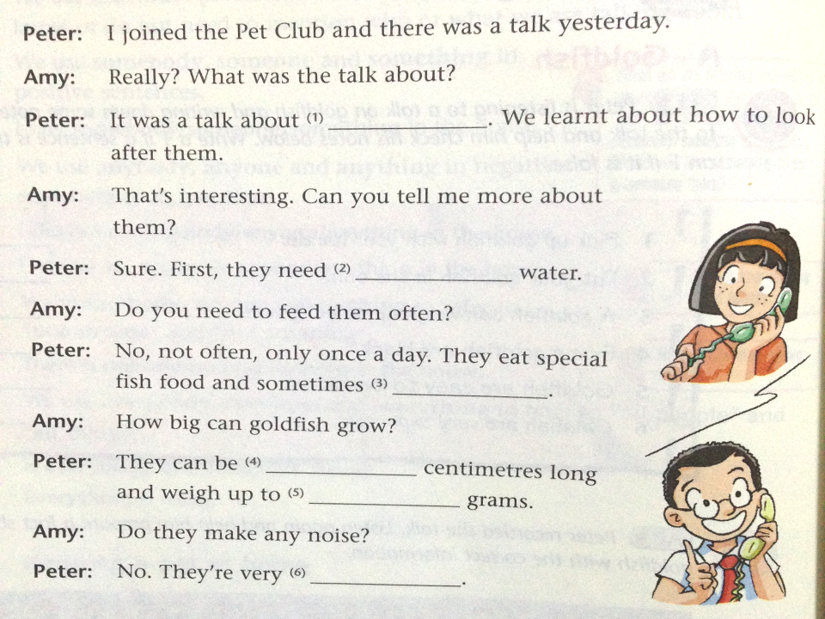
goldfish
After the talk, Peter calls Amy to tell her about goldfish. Complete Peter’s answers with the help of the information on page 99. (P 100)
A3
clean
vegetables
20
400
quiet

Slide 9
如何照顾……
goldfish
Observe the underlined expressions.
clean
一天一次
vegetables
重达……
20
400
quiet
制造噪音

Slide 10
Translate the expressions below into English.
1. 如何照顾……
2.一天一次
3.重达……
4.制造噪音
how to look after…
once a day
weigh up to…
make noise

Slide 11
Speak up:
How do you look after your pets?
Listen to the conversation and answer
the following questions.
1. How does Millie look after her dog?
2. How does Amy look after her cat?
3. How does Peter look after his fish?
She walks her dog in the park every evening.
She brushes her cat’s fur every day.
He puts his fish in clean water, and never feeds them too much.

Slide 12
Fill in the blanks.
Daniel: How do you _________your dog, Millie?
Millie: Dogs like ________a lot, so we _____
him in the park every evening.
Daniel: Oh, I ____. Do you walk your cat, Amy?
Amy: No, we don’t. We only ______________
every day.
Daniel: _____ do you _________ your fish,
Peter?
Peter: We ____ them ___ clean water, and we
never ____ them _________.
look after
exercise
walk
see
brush her fur
How
look after
put in
feed
too much

Slide 13
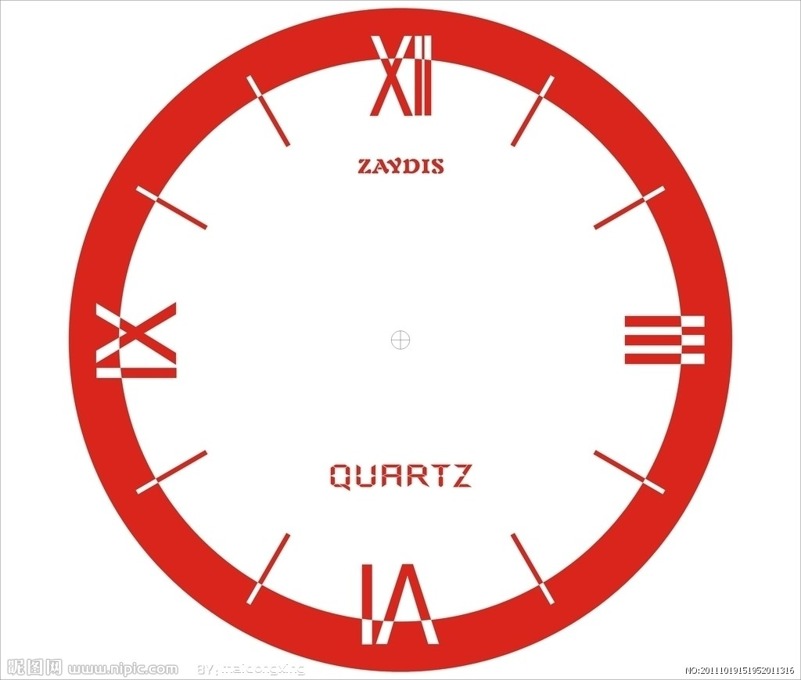

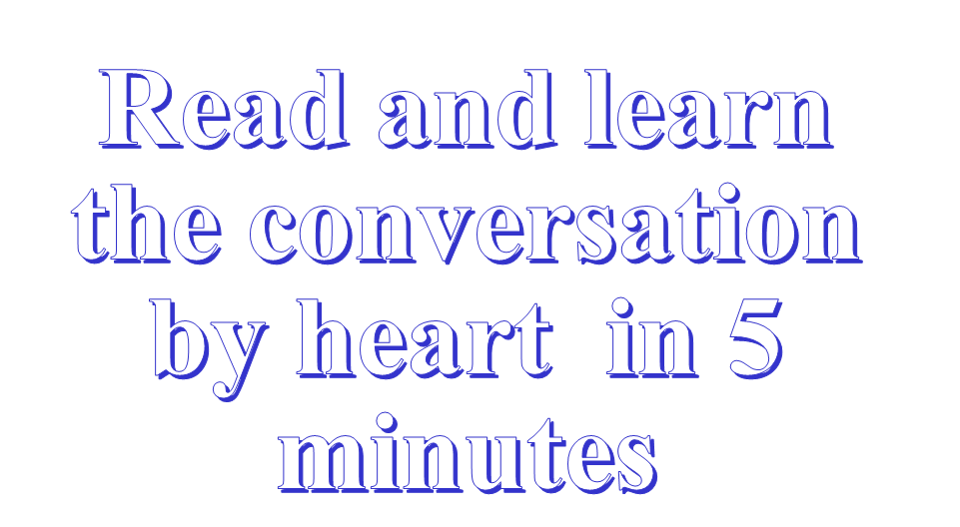

Slide 14
Role-play
We’ll see which group does the best.
Daniel
How do you___ ___ your dog, Millie?
Oh, I ______. Do you ___ your cat, Amy?
How do you ____ ____ your fish, Peter?
Millie
Dogs like _____ a lot, so we____ him in the park every evening.
Amy
No, we don’t. We only ____ her _____ every day.
Peter
We ____ them ___ clean water, and we never ____ them ____ ____.

Slide 15
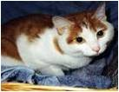
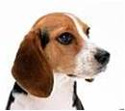
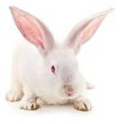
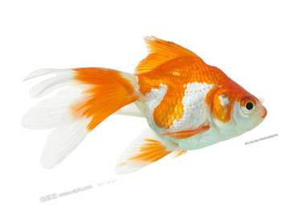
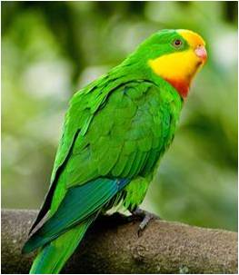

What’s your favourite pet?
I really like….
It’s your turn
Work in groups and talk about pet care. Use the conversation above as a model.
Because it is….
Why?
Pair work
How do you look after your…?
I feed it…once a day. / I put it in clean water/brush her fur….

Slide 16

Language points
1. … can grow up to be 20 centimetres long and can weigh up to 400 grams.
grow up: to develop from being a child to being an adult “成长,长大成人”
Practice
1) 你长大后想当什么？
What do you want to be when you grow up?
2) 我是在芝加哥长大的。
I grew up in Chicago.
3) 她长大后想成为一名医生。
She wants to be a doctor when she grows up.

Slide 17
1. … can grow up to be 20 centimetres long and can weigh up to 400 grams.
weigh: v. “重量为……”
weigh up to “重达……”，后面直接跟所称对象的重量数。
Practice
1) 你有多重？
How much do you weigh?
2) 我胖的时候重量达到一百公斤呢。
I weighed up to 100 kg when I was fat.
3) 您可以携带30公斤的行李。
Your luggage can weigh up to 30 kilos.

Slide 18


Quiz
注: 另附word文档。
点击此处链接

Slide 19
I.英汉互译
在阳光下
1. in the sun _______________
2. brush her fur ________________
3. walk the dog ________________
4.长成；成大成人 ________________
5.发出一些噪音 ________________
6.重达…… ________________
7.照顾
______________________
刷它的皮毛
遛狗
grow up
make some noise
weigh up to...
lool after/take care of

Slide 20
Ⅱ翻译下列句子
猫喜欢在太阳下睡觉。
The cat likes to sleep in the sun.
2. 金鱼很好照顾。
Goldfish are easy to look after.
3.你长大后想去哪里？
Where do you want to go when you grow
up?
4.不要吵闹，你妹妹在做作业。
Don’t make any noise. Your sister is doing homework.

Slide 21
Homework
1. Finish the exercises in Learning English.
2. Preview Study skills on page 101.
3. Preview Task on pages 102-103.

